Slide 1
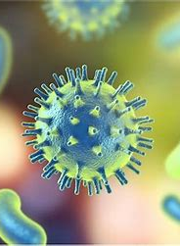
Immunity
GTHBY Human Biology

Slide 2
Review
List the 5 inflammation responses.
Explain the difference between and antiseptic and a disinfectant, using examples of substances and applications.
What problems can oversubscription of antibiotics cause?
Why should you take the whole course of antibiotics, even if you feel better?
Why are bacterial infections often more dangerous than viral infections?

Slide 3
Learning Intentions
Types of natural and artificial immunity leading to the production of memory cells

Slide 4
Success criteria
Explain the difference between natural and artificial immunity.
Identify types of cells associated with the immune system, their role, source and description.

Slide 5
The Immune System
The immune system is a complex network of organs, cells and proteins that defends the body against infection, whilst protecting the body's own cells. The immune system keeps a record of every germ (microbe) it has ever defeated so it can recognise and destroy the microbe quickly if it enters the body again.

Slide 6
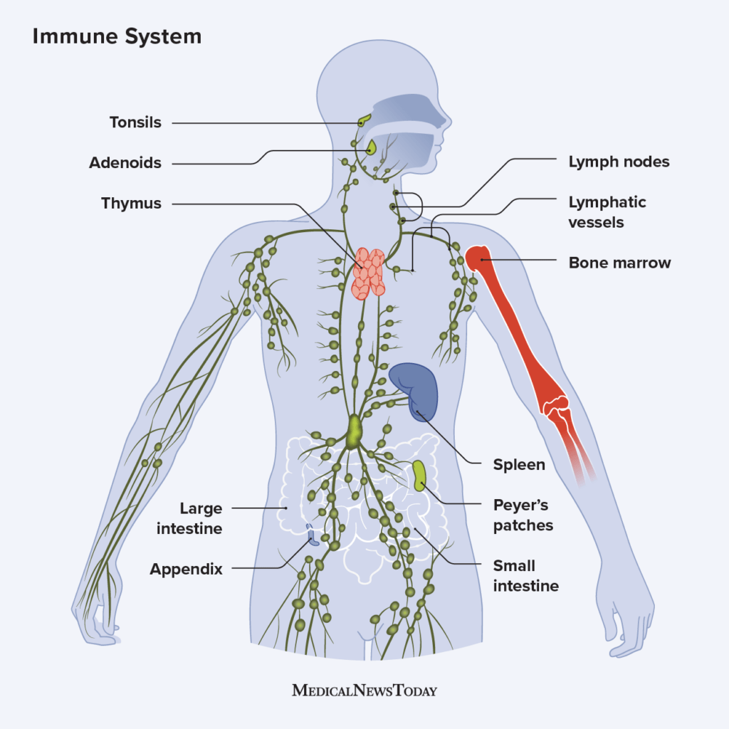
Organs of the immune system

Slide 7
Components of the immune system
white blood cells (leukocytes)
the spleen
the bone marrow
the lymphatic system
the thymus
the tonsils, adenoids, and appendix
blood and lymphatic vessels.

Slide 8
The Immune Response
The immune system needs to be able to distinguish healthy from unhealthy cells and tissue to work effectively.
An antigen is any substance that can spark an immune response, eg is a bacterium, fungus, virus, toxin, or foreign body or a cell that is faulty or dead. The immune system recognises the antigen as an invader and launches an attack.

Slide 9
White Blood Cells (leukocytes)
Phagocytes attack and kill pathogens.
Lymphocytes help the body to recognise previous invaders and how to fight them if they should return, by producing antibodies against each antigen.

Slide 10
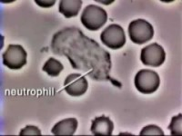

Slide 11
Antibodies and Antigens
Once the body produces an antibody, it keeps a copy so that if the same antigen appears again, the body can deal with it more quickly.

Slide 12
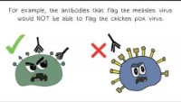

Slide 13
Natural immunity
There are three types of immunity in humans:
Innate eg we are born with white blood cells which will attack any foreign antigens
Acquired eg after being exposed to the disease
Passive eg newborn gets antibodies from its mother’s placenta and milk

Slide 14
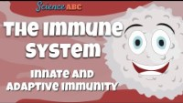

Slide 15
Artificial immunity
Vaccinations introduce weakened pathogens or their antigens so they will be able to produce antibodies without getting sick.

Slide 16
Success criteria
Explain the difference between natural and artificial immunity.
Identify types of cells associated with the immune system, their role, source and description.

